Slide 1

FLDR
IST 615 Final Project
Bryan D’Amico, Surafel Makonnen, Erik Newcome, Adam Vajdak
Notes:
Welcome to our presentation on Folder. We hope by the end you will be as excited about this business opportunity as we are.

Slide 2

Ask any teacher and they’ll tell you…
Schools have tons of paperwork to keep track of
Report cards, transcripts, IEPs, 504s, standardized test scores, behavioral and cognitive evaluations, medical information, and more
Many public schools have aging infrastructure and practices
Forms filed away on paper
Scans saved to laptop hard drives
Files need to be tracked down and sent around
Taking time away from students
Schedules change rapidly at the beginning of each school year
Difficult to keep track of who has what
This great shuffling of forms is a security risk
FERPA, HIPAA
Notes:
Talking to teachers we hear about how much paperwork they deal with, from transcripts to IEPs and evaluations. Many public schools do not have great solutions to store and help staff access these files, just filing them away on paper. This takes up a lot of time as teachers need to track these down as students are constantly changing schedules at the beginning of the year. All this shuffling of forms could even cause a bad situation violated FERPA or HIPAA regulations.

Slide 3

How Can FLDR Help?
Collaborative, safe, agile online environment for saving, accessing, sharing, and editing all these forms
Sign up at the school or district level
Each database is isolated and secure
Each staff member has their own credentials
Only access the students they are responsible for
See all the forms associated with those students in one place
Upload old forms or use templates to quickly make new ones
As soon as the form is created, anyone who has that student can see it
Forms can be collaboratively edited in real time
Self-contained, single purpose application
Easy to use even for those who are not tech-savvy
Notes:
FLDR is the next evolution in document storage and sharing for schools. Schools can sign up at the district or school level and enjoy their own secure database. Every staff member has their own login to access our web-based platform. Here they see only the students they need to see and all their documentation in one place. FLDR makes it easy to migrate existing forms and even easier to work on new ones. This self-contained, single purpose application is easy to use even for the non-technical teachers.

Slide 4
The Power of FLDR
No more local files
No possibility of forms getting lost or stolen
Secure and encrypted – follows all regulations
Instant access to what you need when you need it
No more needing to ask others or look out for emails
Reclaim already limited time for important duties
No more worries about remembering what services need to be provided for students
Notes:
With FLDR there’s no more local files, always having instant access, precious time back for teachers to plan and teach, and no more worries

Slide 5
Imagine this situation instead
There is an upcoming special education eligibility meeting for a student
The counselor starts a new template under the student for teachers to fill out their progress report
Each teacher has their own page
Every teacher logs on, goes to that student, fills in their template, and its saved automatically
No more coordinating with anyone or delivering any forms
During the meeting, participants log on, and have all the forms on hand
Anyone can take notes or make updates during the meeting
Nothing can get lost or forgotten
This is the new reality schools can expect when they choose FLDR
Notes:
FLDR makes tasks easy. Teachers can easily start new documentation for special education eligibility. All the teachers can collaborate and save their class updates for the student. No transferring of files takes place, but everyone has live access at the meeting. Nothing is lost or forgotten, and everything is faster and easier. This is the new reality we want school staff to imagine when they hear about FLDR.

Slide 6

Technical Solution Options
Similar, cloud based, solutions from Azure and AWS
Comparison of an on-prem solution with servers from Dell
All solutions account for the following needs
1 combo DB and Apps server
5 presentation servers running VMWare Horizons
Cloud options were provisioned with a Domain Controller to leverage a limited one-way trust with the school's Active Directory Domain for end user authentication
The on-prem option would leverage the existing AD environment

Slide 7
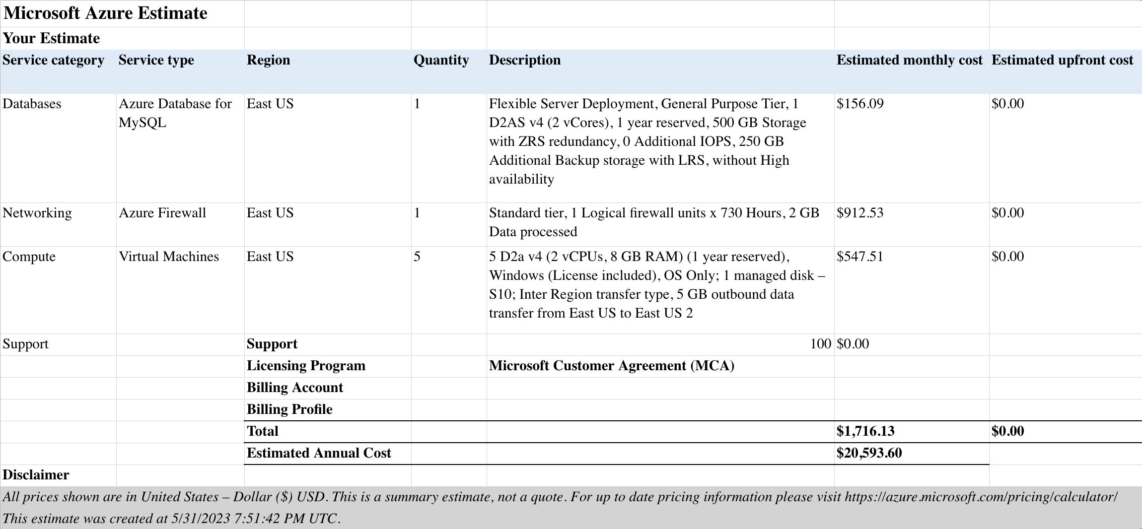
Microsoft Azure

Slide 8
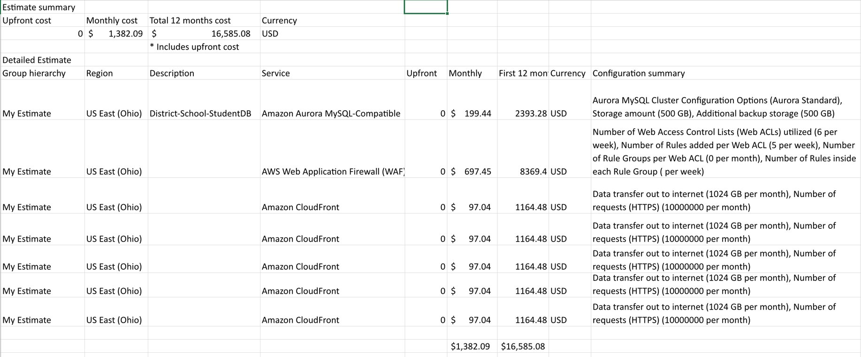
Amazon Web Services

Slide 9
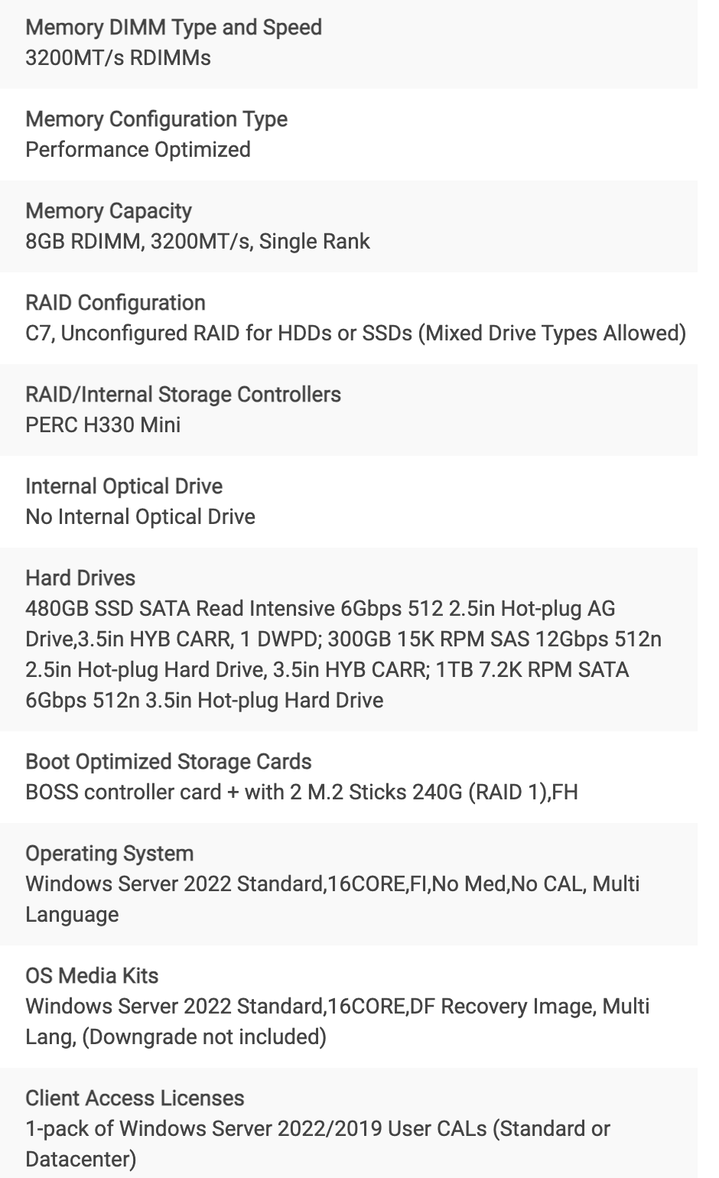
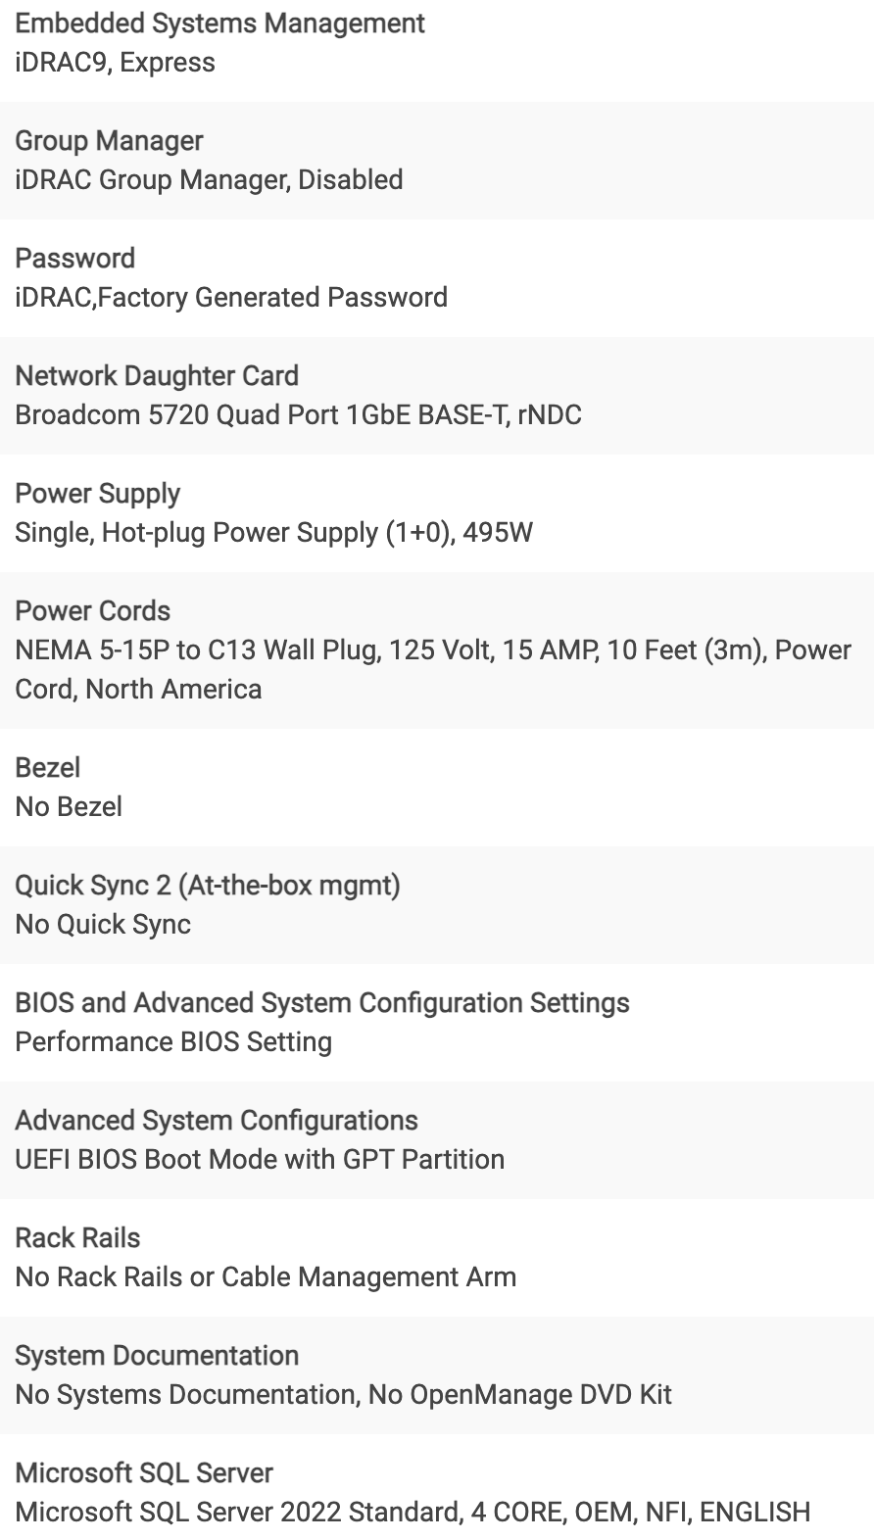
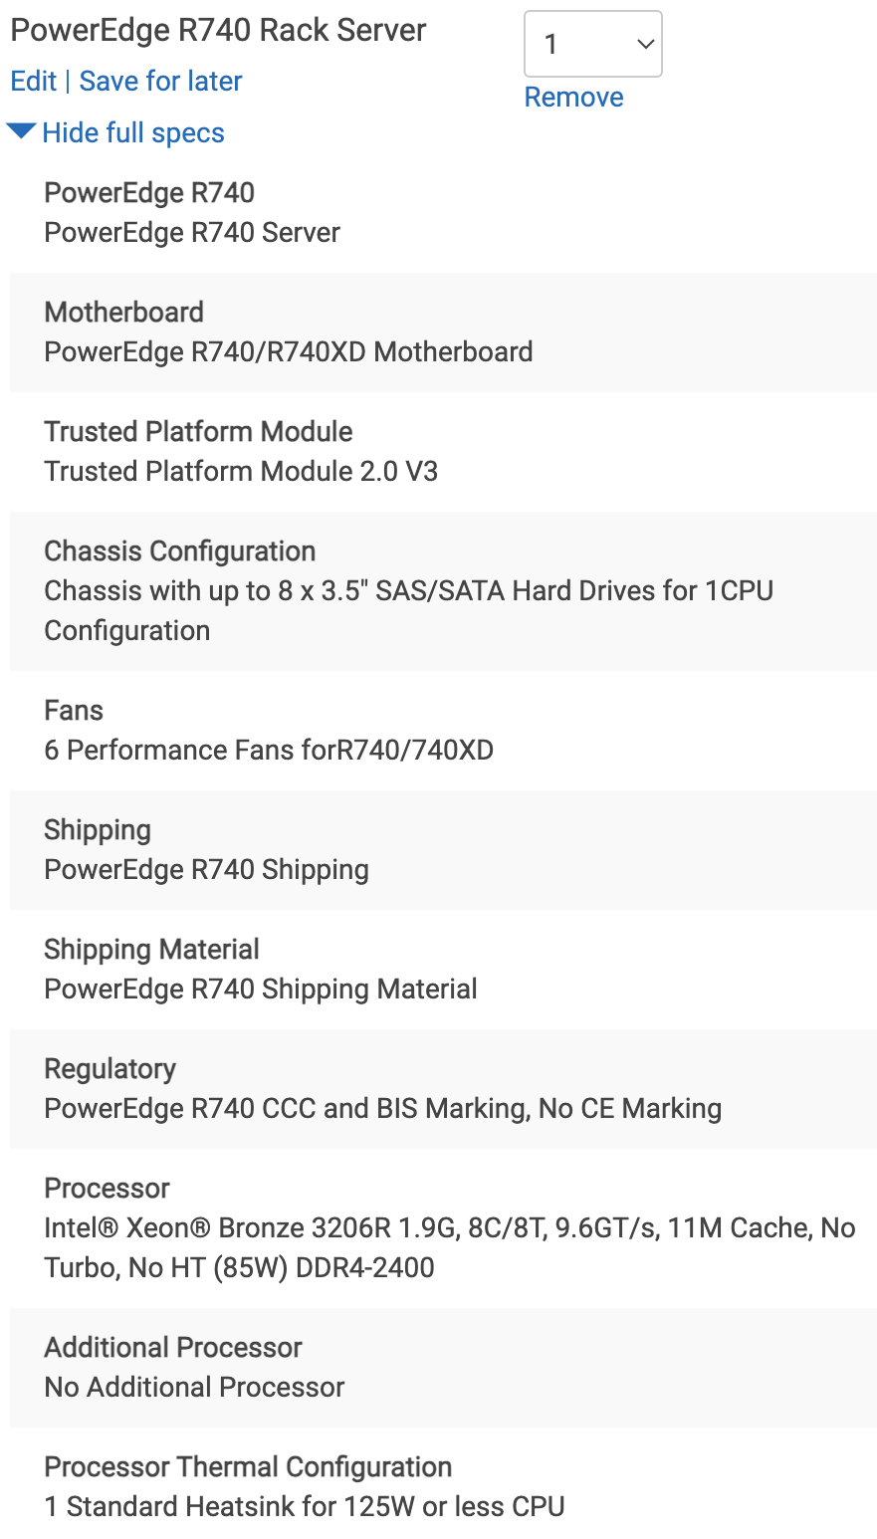
Dell On-Prem DB and App Server w/ SQL
$14,717.89

Slide 10
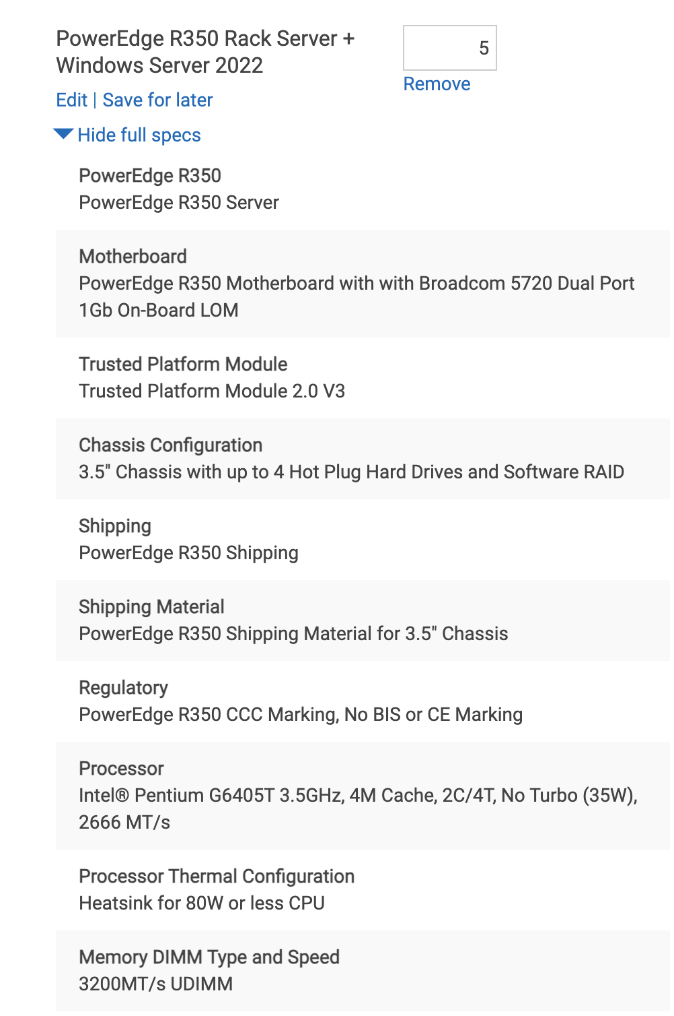
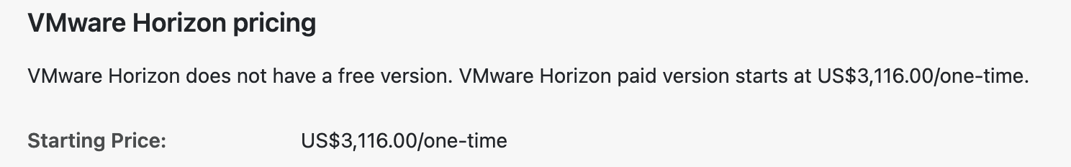
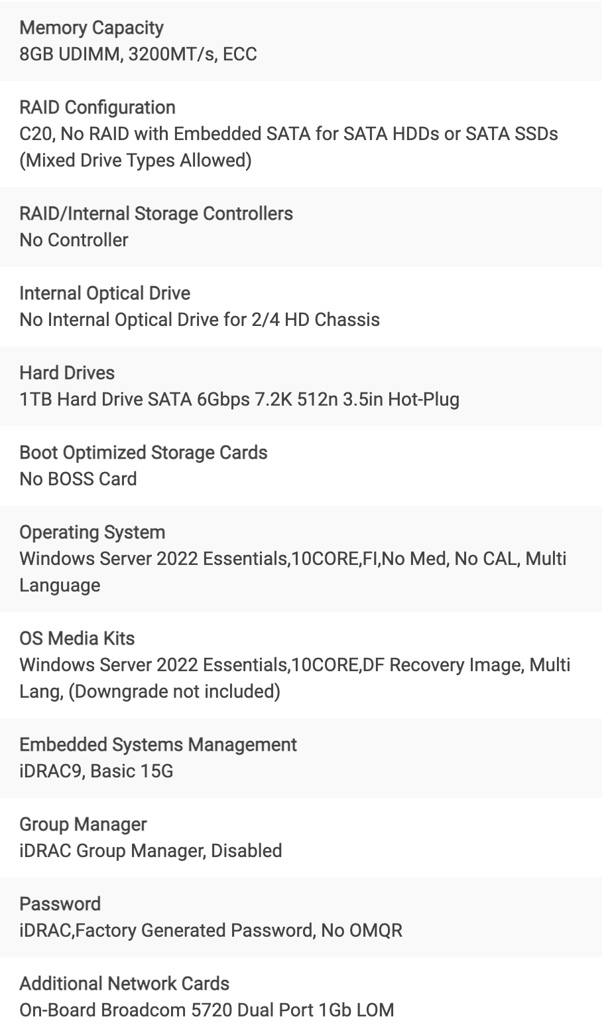
Dell On-Prem Presentation Server and SW
$9950.67 for 5 servers

Slide 11

Financial Analysis: On-premises
Qty 1 DB/App server w/ SQL - $14,717.89
Qty 5 Presentation Servers - $9,950.67
HW Total - $24,668.56
VMWare Horizons VDI - $3,116
Grand Total for On-Prem Solution - $27,784.56 -TCO
+ monthly/yearly maintenance after the 3 years support runs out
+ extras, such as internet cost to host, energy and cooling, location set up. On site tech.

Slide 12

Financial Analysis: Cloud
TCO
Amazon Web Services
Initial month $2,382 counting in cost of uploading estimated 10,000 files.
Then $1,382 monthly.
Totaling $17,584 for the first year and $16,584 for the subsequent year.
Microsoft Azure
Initial month $2,716 counting in cost of uploading estimated 10,000 files.
Then $1,716 monthly.
Totaling $21,592 for the first year and $20,582 for the subsequent year.

Slide 13
Why Choose FLDR?
Dedicated solution to solve document management needs
Many benefits from leveraging FLDR to centralize documentation
Enhance efficiency, streamline tasks, help students

Slide 14

Five Key Benefits
Saving time and money
Repurpose previous space used to store documents
Enhanced accessibility
Quick and easy access to information
Efficient record keeping
Faster creation, editing, and monitoring of documents

Slide 15
Five Key Benefits
Collaboration
Improved communication between staff leads to better relationships with students and families
Refocusing of Responsibilities
Teachers and administrators can focus on their jobs - creating great learning experiences for students

Slide 16
Proposed Funding
$10 million initial funding
Team of eight including developers, IT, project manager
Competitive salaries averaging $100k
~$25k per year for Azure
Attractive pricing for FLDR, $2k per year for school subscription
Other learning services can cost over $150k per year
After 3 years, with just 3% of public schools subscribing
$5.4 million in revenue per year
Goal for within 10 years, 10% of public schools
$18 million in revenue per year
Notes:
We are looking for $10 million in initial funding to gather a team of talented developers and account for Azure costs, while having some money for advertising and other costs. Pricing FLDR very competitively should increase draw to the product. If we even have a 3% customer base of the 90,000 public schools in the US we will see 5.4 million in revenue, and by 10% approximately 18 million with negligible costs on our end to scale up the Azure services. With that revenue we can expand our team and bring on more customers.

Slide 17

Thank you
We hope you will choose to join us on FLDR’s exciting journey
Any questions?

